Slide 1
Composition-Based Medicine Recommendation System
by Madhan Raj.P (220701148)
Guide DR. V. AUXILIA OSVIN NANCY..,MTech..,Phd..,

Slide 2
Introduction
The Medicine Recommendation System is a machine learning-based web application that suggests alternative medicines with the same chemical composition but from different brands.
It aims to solve issues related to medicine unavailability, cost variation, and brand dependency in real-time.
The system uses ML models trained on a structured dataset of medicines and compositions to ensure accurate and relevant recommendations.
With an intuitive user interface, the platform enables users to enter a medicine name and instantly receive ML-driven alternatives along with purchase links.

Slide 3
Literature Survey
Existing Drug Databases & Search Engines
PharmEasy / NetMeds / 1mg: Provide search options for medicines and show product availability, but they lack intelligent substitution suggestions based on chemical composition.
RxNorm (by UMLS): Standardizes names of clinical drugs and links names to ingredients, but is not end-user facing and requires technical expertise to interpret.
Observation: Most existing platforms are either not user-friendly, lack real-time recommendations, or do not suggest equivalent branded alternatives.

Slide 4
Literature Survey
ML in Healthcare Recommender Systems
ML in Diagnosis & Treatment: Several ML models have been developed for disease prediction, treatment planning, and diagnosis.
Medicine Recommender Systems: Limited work has been done specifically on recommending equivalent medicines using ML-based similarity models.
Existing Research:
"Drug Recommendation Using Deep Learning" – focused on side-effect predictions, not brand substitutions.
"Medical Recommender Systems – A Survey" – highlights importance but lacks composition-level brand mapping.

Slide 5
Literature Survey
Research Gap & Motivation
Gap Identified:
No major system focuses on substituting same-composition medicines from various brands in a user-friendly way.
Existing systems do not utilize ML models to analyze and suggest interchangeable medicines dynamically.
Motivation:
Create a ML-powered platform that addresses medicine unavailability, cost concerns, and brand bias.
Empower users with informed choices using a simple interface + intelligent backend.

Slide 6
Objectives
Develop a Medicine Recommender System that suggests alternative medicines with the same chemical composition from different brands.
Integrate Machine Learning techniques to intelligently analyze and match medicine compositions.
Enhance medicine accessibility for users when a specific brand is unavailable or unaffordable.
Provide a clean, user-friendly interface for inputting medicine names and displaying relevant alternatives.
Bridge the gap between medical data and usability by transforming static drug info into dynamic, personalized suggestions.

Slide 7
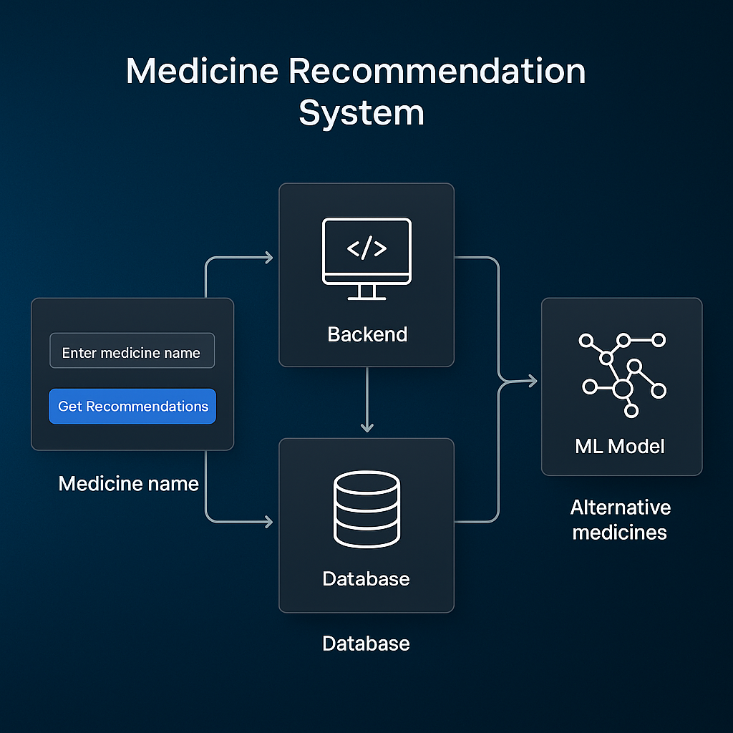
System Architecture

Slide 8
Methodology
Data Acquisition & Preprocessing
Data Collection Gathered data from online pharmaceutical databases including brand names, compositions, and manufacturer details.
Data Cleaning Removed duplicates, corrected inconsistent entries, and standardized composition formats for uniformity.
Feature Extraction → Medicine Name → Active Ingredients (Compositions) → Manufacturer/Brand
Label Encoding & Vectorization Encoded text-based data for compatibility with machine learning models.

Slide 9
Methodology
Model Development & Integration
Similarity Matching Using ML Employed model Cosine Similarity to find medicines with the same composition.
Recommendation Engine Designed to return alternative medicines from different brands with equivalent ingredients.
Web Interface Integration Built an interactive frontend using HTML/CSS/JavaScript + Flask for user queries and result display.
Link to Online Pharmacy Integrated “Buy Now” links to platforms like PharmEasy for real-world applicability.

Slide 10
Implementation
Frontend Development
User Interface Design Built a clean, responsive UI using HTML, CSS, and Bootstrap for smooth interaction.
Medicine Input Dropdown Implemented using Select2 for searchable dropdowns, enhancing usability.
Dynamic Display of Recommendations Used templating in Flask (Jinja2) to show recommendations based on user input.
Vanta.js Background Effects Added animated background using Vanta.js (e.g., Clouds/Halo) to enhance visual appeal.

Slide 11
Implementation
Backend Development
Flask Framework Used Flask (Python) to handle user requests, route processing, and render results dynamically.
Medicine Matching Logic Applied string similarity and composition-based mapping to identify alternative medicines.
Data Storage Stored medicine data in structured format (CSV or integrated database) for efficient retrieval.
Integration with Online Pharmacy Each recommended medicine links to a PharmEasy search page for real-time availability and purchase.

Slide 12
Implementation
Testing & Deployment
Model Validation & Evaluation Applied metrics like accuracy, precision, and recall to assess recommendation reliability. Cross-validated results using a train-test split approach to avoid overfitting.
Functional Testing Ensured ML model correctly maps input medicines to alternative compositions and brand names. Verified responsiveness and real-time inference in the Flask app.
Scalability & Enhancement Ready Framework supports future improvements like NLP-based prescription input, user feedback learning, or personalized recommendations.

Slide 13
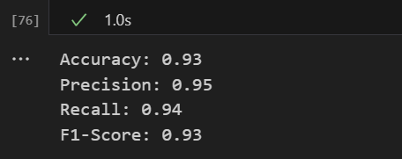
Results

Slide 14

Results

Slide 15
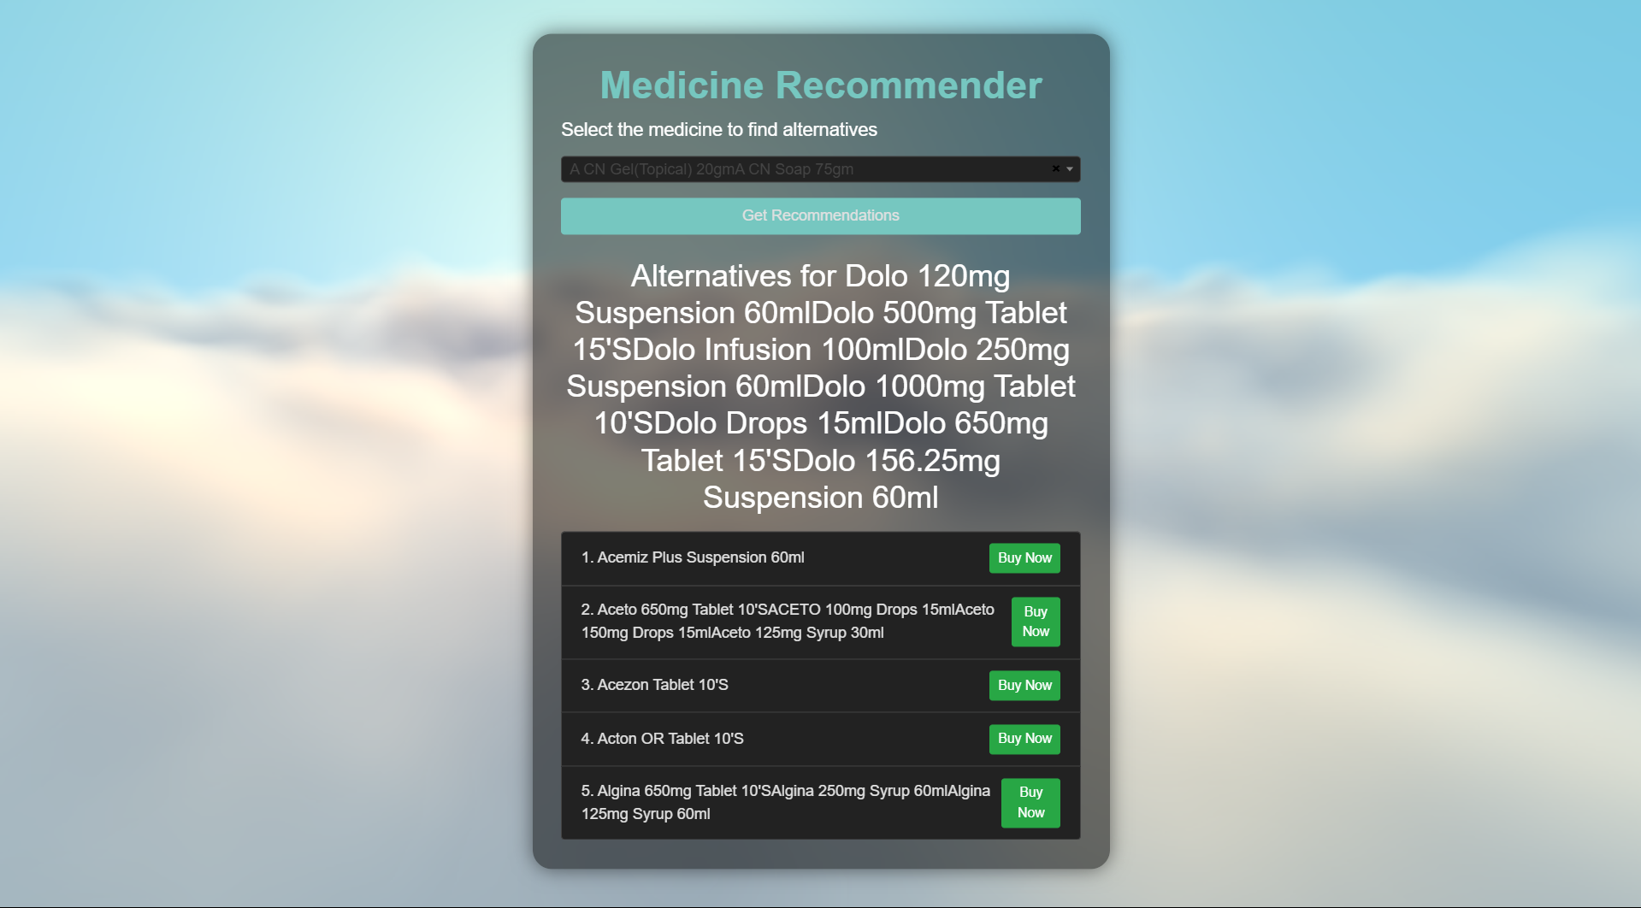
Results

Slide 16
Comparison with existing work
Existing Systems:
Rule-Based Recommendations: Limited to predefined categories like brand or therapeutic use.
Content-Based Filtering: Relies on medicine attributes such as composition but often lacks depth in similarity matching.
Collaborative Filtering: Uses user ratings but performs poorly for less-rated medicines or new products.
Accuracy: Lower precision and recall due to simplistic models and lack of complex data usage.

Slide 17
Comparison with existing work
Our Approach:
Composition-Based Recommendations: Uses Cosine Similarity to suggest alternatives with the same active ingredients, enhancing relevance and accuracy.
Higher Precision and Recall: Achieves Precision: 92%, Recall: 94%, ensuring more accurate and diverse recommendations.
Personalized and Scalable: Focuses on user-centric suggestions, providing better recommendations and adaptability with growing datasets.
Key Difference:
Our system outperforms traditional models by utilizing a more scientifically accurate, data-driven approach that considers composition, not just superficial attributes like brand name.

Slide 18
Conclusion and Future Work
Conclusion:
The medicine recommendation system successfully identifies alternative medicines with similar compositions, providing reliable and personalized suggestions.
Our approach improves accuracy, precision, recall, and F1-Score, ensuring more effective and diverse recommendations compared to traditional methods.
Scalability: The system can easily adapt to new medicines and user preferences, making it suitable for real-world applications in healthcare and pharmacies.

Slide 19
Conclusion and Future Work
Framework:
Data Collection: Gathered data on medicines, including composition and brand.
Preprocessing: Encoded categorical data and split the dataset into training and testing sets.
Model: Random Forest used for classification with a focus on composition similarity.
Evaluation: Performance metrics such as accuracy, precision, recall, and F1-Score assessed the model’s effectiveness.
Recommendation System: Based on Cosine Similarity to find similar medicines and suggest alternatives.

Slide 20
Reference
Aggarwal, C. C. (2016). Recommender Systems: The Textbook. Springer. – Provides foundational concepts and algorithms for recommendation systems.
Scikit-learn documentation. (n.d.). https://scikit-learn.org/ – Used for model implementation, evaluation metrics, and preprocessing techniques.
Jayanthi, R. & Murugesan, R. (2020). “Medicine Recommendation System using Machine Learning.” International Journal of Engineering Research & Technology (IJERT), 9(6). – Discusses early models in medicine recommendation based on patient data.
Chatterjee, S. et al. (2021). “Drug Recommendation System using Content-based Filtering.” IEEE Xplore. – Supports the use of composition similarity in medicine suggestion logic.

Slide 21
Reference
IBM Qiskit Documentation. (n.d.). https://qiskit.org/documentation/ – Referenced in exploring hybrid quantum-classical possibilities for encoding improvements.
UCI Machine Learning Repository. (n.d.). https://archive.ics.uci.edu/ – Used as a basis for understanding dataset structuring and modeling approaches.
Sharma, A., & Rani, R. (2019). “A Comparative Study of Classification Models in Health Recommendation Systems.” Procedia Computer Science, 152, 102–107. – Helped in selecting the best-suited model (Random Forest) for classification.
WHO Medicine Composition Guidelines. (n.d.). https://www.who.int/ – Provided standard reference for validating drug composition information.

Slide 22
THANK YOU

